Slide 1
SAP Gateway
Day 1
<Trainer>
Capgemini, India

Slide 2
SAP Gateway Day 1 - Agenda
What is SAP Gateway?
Introduction about SAP Gateway
SAP Gateway Overview and Architecture
SAP Gateway – Deployment options
REST Architecture

Slide 3
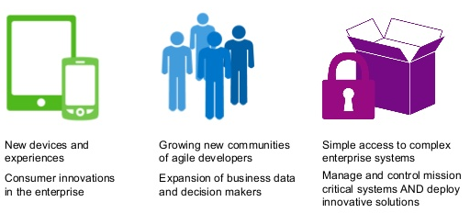
SAP Gateway
What is SAP Gateway?
Any Environment, Any Device, by Any Developer
SAP Gateway lets you empower users with secure, personalized solutions that leverage and extend your existing SAP infrastructure, all with security, robustness, agility, and efficiency. SAP Gateway lets you meet the changing needs of your business at the speed of business by enabling People agility, System agility and Process agility.

Slide 4
Capabilities of SAP Gateway
Open - Any Device, Any Experience, Any Platform
People - Optimized for User Interaction Scenarios
Timeless - Non disruptive, any SAP Business Suite version
Developers - Simple APIs, no SAP knowledge, any tool
Standards - Based on REST, ATOM/OData
Opening the doors for millions of developers to create solutions connecting to SAP
Increase workforce productivity
Reduces Complexity , skill set requirements and deployment barriers
Shorten development times/cycles
Engage all developers with their choice of development tools
It offers connectivity to SAP applications using any programming language

Slide 5
Benefits of SAP Gateway
Hides the technical complexities of your SAP system landscape behind a single interface that is easy-to-use and non-proprietary.
Makes your SAP business data and functionality accessible to any external device.
Communicate using the HTTP(S) protocol.
Understand OData messages.
Provides Service Provisioning tools that allow the quick REST-enablement of existing ABAP functionality.
Provides plug-ins for well known IDEs such as Eclipse, Visual Studio 2010 and XCode.

Slide 6
Focusing area of SAP Gateway
Any external business application. E.G. Microsoft Office applications via a .Net (or even VBA) interface
Desktop machines using Web-based applications running PHP or Java or Ruby, etc.
Native applications on mobile devices E.G. iPad/iPhone or an Android device or a Blackberry.
Embedded devices such as manufacturing robots or route planning software in Satellite Navigation systems.
Any other business scenario you can think of involving some programmable device that can speak HTTP(S).
The SAP Gateway interface can be used to supply the SAP Business Data to any programmable device that can speak HTTP(S).

Slide 7
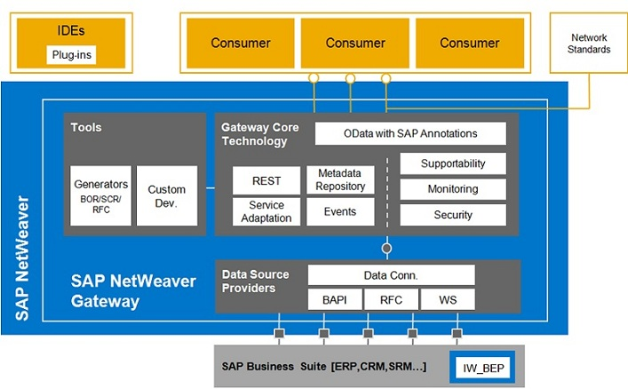
SAP Gateway Architecture

Slide 8
Deployment Options
HUB Architecture:
Gateway server functionalities are only used on one dedicated server, the hub system. The services are deployed on the backend systems and are registered on the server. The Gateway service is thus deployed in the Gateway backend systems where either IW_BEP is deployed systems or that are running on top of 7.40 leveraging the core component SAP_GWFND.
Embedded Architecture:
In this case the services are registered as well as published in the SAP Business Suite backend system.

Slide 9
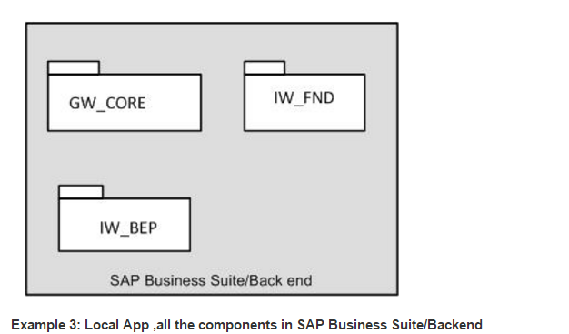
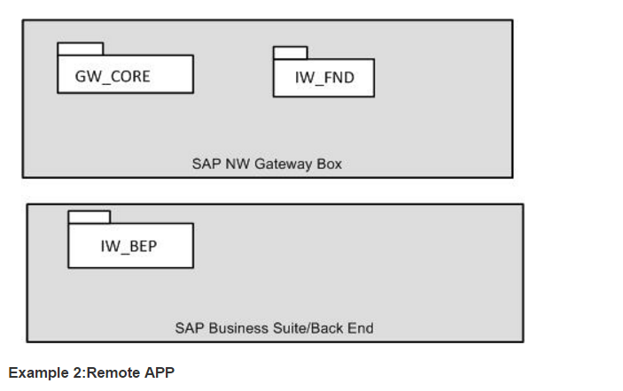
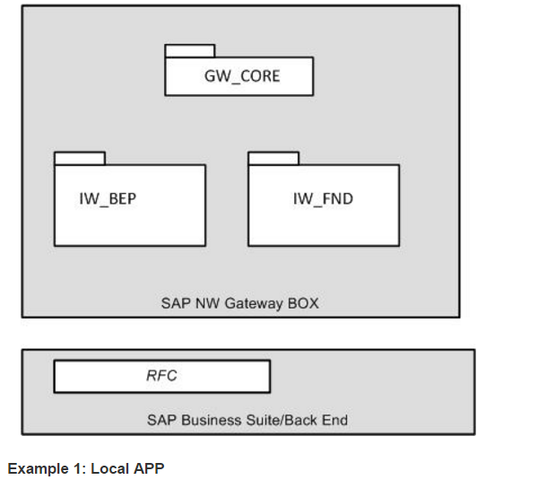
Gateway Components

Slide 10
Question & Answers
What does REST stands for?
Representational State Transfer
Which architecture SAP recommends?
SAP recommends Central HUB architecture as a first option, and again it depends upon the client landscape, which one to implement.
How is SAP Gateway different from Web services?
Web services are based on SOAP services and SAP Gateway is REST-based. SAP Gateway focuses on consumption scenarios and SOAP is more process-to-process and machine-to-machine.
Security Level in SAP Gateway?
SAP Gateway supports
- Browser Based SAML 2.0 Authentication.
- x.509 Client Certificate authentication
- SAP Logon tickets(SSL)
- Basic Authentication
SAP Net weaver Gateway Vs SAP Gateway
Only the calling name has been changed, and the architecture remains the same.

Slide 11
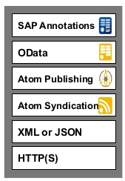
What is Open Data Protocol
OData is Microsoft developed extension to the Atom Publishing and Atom syndication Standards, which in turn are based on XML and HTTP(S).
It is Standardized protocol, built over existing HTTP and REST protocols supporting CRUD(Create, Read, Update and Delete) operations.
We can call it as ODBC Web.
It can be used freely without the need for a license or contract.
It uses ATOM+XML or JSON.
REST-based architecture.

Slide 12
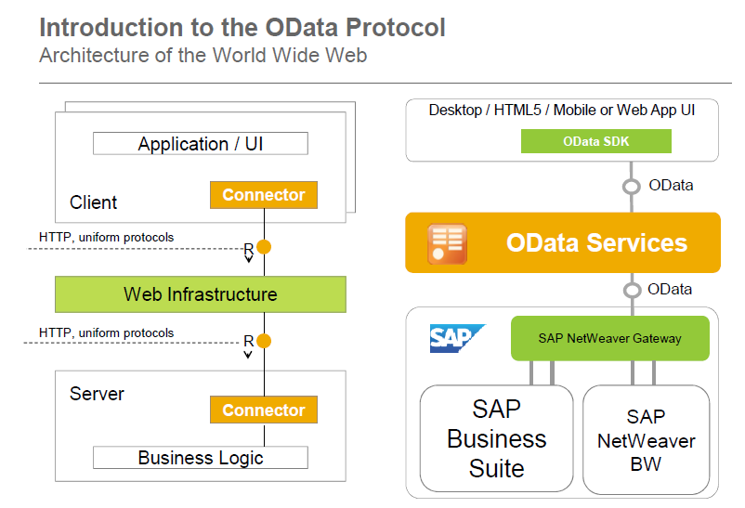
OData Protocol: WWW Architecture

Slide 13
REST Architecture
REST is an architectural framework and methodology which is based on addressability, statelessness, connectedness and uniform interface.
OData is an implementation of REST.
HTTP(S) – An Implementation of the REST constraints:
HTTP(S) is the protocol that drives the World Wide Web
A Server-side resource can be manipulated in four basic ways.
These four basic REST operations have given rise the acronym CRUD.
REST Operation | HTTP Method
Create Resource | POST
Retrieve one or more Resources | GET
Update Resource | PUT
Delete Resource | DELETE

